Slide 3
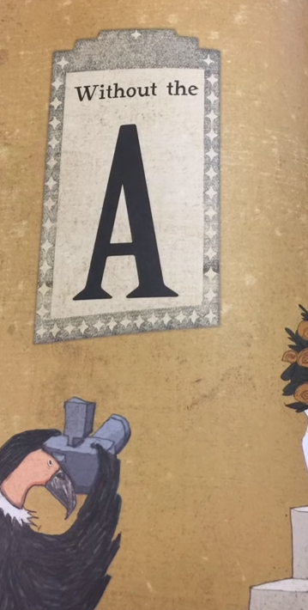

Slide 6
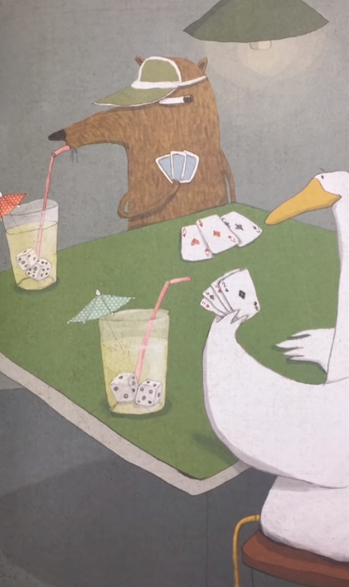

Slide 15
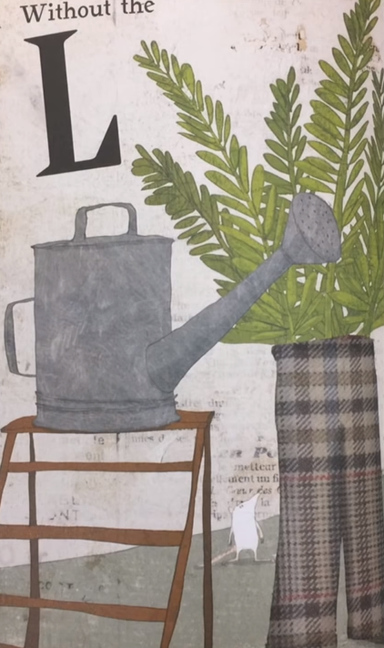

Slide 18
Teaching resources
https://www.youtube.com/watch?v=eCk2wQuUDaM&ab_channel=ReadMeABook
Take away the A

